Slide 1
CONCRETE CRACK DETECTION SYSTEM- PHASE 3

Slide 2

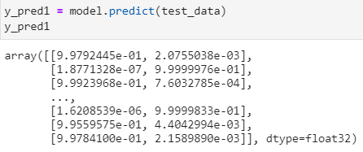
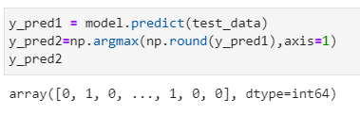
PREDICTING LABELS
Model test data prediction comes as floating numbers. It will not be feasible to compare these floating numbers with true test labels. So, the floating point are rounded into integers.
Furthermore, np.argmax() is used to select the index number which has a higher value in a row
Fig 1: Class labels
Fig 2: Test label prediction (y_pred)
Fig 3: Test data label predictions

Slide 3
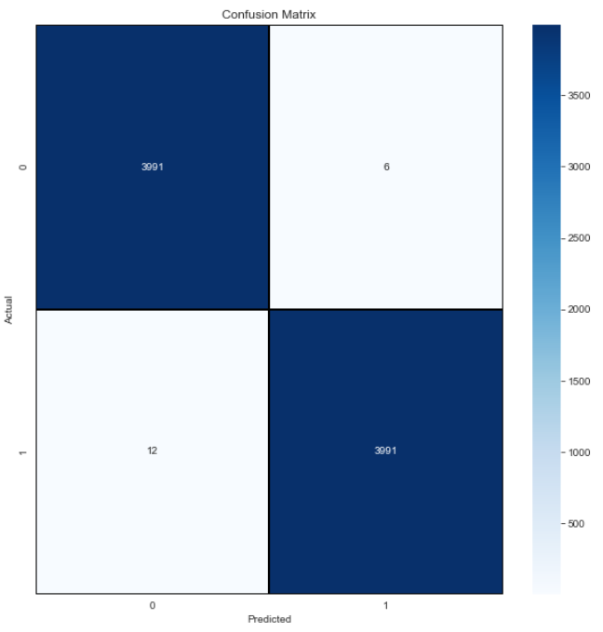
CONFUSION MATRIX
A confusion matrix is a predictive analytic tool. Specifically, it is a table that displays and compares actual values with the model’s predicted values .
Fig 4: Confusion matrix

Slide 4
CONFUSION MATRIX (CONT’D.)
True Positive (TP)
True positive represents the value of correct predictions of positives out of actual positive cases. Out of 4003 actual positives, 3991 are correctly predicted positive. Thus, the value of true positive is 3991.
False Positive (FP)
It represents the value of incorrect positive predictions. The value represents the number of negatives(out of 3997) which gets falsely predicted a positive. Out of 3997 actual negatives, 6 is falsely predicted as positive. Thus, the value of false positive is 6.
True Negative (TN)
True negative represents the value of correct prediction of negatives out of actual negative cases. Out of 3997 actual negatives , 3991 are corrected predicted as negatives. The value of true negatives is 3991.
False Negative (FN)
False Negative represents the value of incorrect negative predictions. This value represents the number of actual positives (out of 4003) which gets falsely predicted as negatives. Out of 4003 actual positives, 12 is incorrectly predicted as negatives. Thus, the value of False Negative is 12

Slide 5
PERFORMANCE METRICS (PRECISION, RECALL, F1-SCORE AND ACCURACY)
Precision
It represents the model's ability to correctly predict the positives out of all the positive prediction it made. It represents the ratio between the number positive samples correctly classified to the total number of samples classified as positive (either correctly or incorrectly).
Precision score = TP/(TP+FP)
= (3991/(6+3978)
= 1.00
Recall
Model recall score represents the model's ability to correctly predict the positives out of actual positives. The recall is calculated as the ratio of the true positives to the actual positives
Recall score = TP/(TP+FN)
= 3991/(3991+12)
= 1.00

Slide 6
PERFORMANCE METRICS (PRECISION, RECALL, F1-SCORE AND ACCURACY) (CONT’D)
Accuracy score
It represents the model's ability to correctly predict both the positives and negatives out of all the predictions.
Accuracy score = (TP+TN)/(TP+FP+TN+FN)
= (3991+3991) / (3991 + 12 + 3991 + 6)
= 1.00
F1-Score
It represents the model's score as a function of precision and recall score. The F1-score is a way of combining the precision and recall of the model, It is also known as the harmonic mean of the model's precision and recall
F1-score = 2 X Precision score X Recall score / (Precision score + Recall score)
= (2 X 1.00x1.00) /( 1.00+ 1.00)
= 1.00

Slide 7
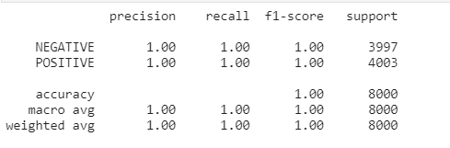
CLASSIFICATION REPORT
Classification report gives a summary table containing precision, recall, F1-score and makes it eaier for us to observe which class performs better
Fig 4: Classification Report Table

Slide 8
PROS AND CONS OF THE CNN MODEL
Pros
In terms of performance, CNN model is very efficient relative to other models
It is simple to implement and requires fewer parameters to build
It is used in various fields and perform major tasks like facial recognition, analyzing documents, understanding climate, image recognition and object identification
Cons
Overfitting is a common problem when training the model especially when we don’t have enough data to train our model with. This problem can be resolve by increasing the data through augmentation.
Another common issue is data loss during the training process. This can be reduced by increasing the number of epochs and increasing the amount of data through data augmentation.
If the CNN has several layers, then the training process takes a lot of time if the computer doesn’t consist of a good GPU.

Slide 9
CONCLUSION
Both classes performed the same in terms of precision, recall and f1-score
My model has a test accuracy of 99.721% which is better than my initial goal of 99.000%. Therefore, my project is successful

Slide 10
REFERENCES
[1] Özgenel, Ç. F. (2019, 07 23). Mendeley Data. Retrieved from Concrete Crack Images for Classification: https://data.mendeley.com/datasets/5y9wdsg2zt/2
[2] SCIENTIFIC, G. (2019, August 17). Evaluating Cracking in Concrete: Procedures. Retrieved from GIATEC: https://www.giatecscientific.com/education/cracking-in-concrete-procedures/
[3] Vadapalli, P. (2021, February 25). Image Classification in CNN: Everything You Need to Know. Retrieved from upgradeblog: https://www.upgrad.com/blog/image-classification-in-cnn/
[4] Wikipedia. (2021, February 13). 2013 Dhaka garment factory collapse. Retrieved from Wikipedia: https://en.wikipedia.org/wiki/2013_Dhaka_garment_factory_collapse
[5] GreekForGreek. (2020, May 18). Keras.Conv2D Class. Retrieved from GreekForGreek: https://www.geeksforgeeks.org/keras-conv2d-class/
[6] Lathiya, A. (9, September 5). Numpy Argmax: How To Use Np Argmax() Function In Python. Retrieved from https://appdividend.com/2020/03/28/python-numpy-argmax-function-example/
[7] ScienceDirect. (2021). Convolutional Layer. Retrieved from ScienceDirect : https://www.sciencedirect.com/topics/engineering/convolutional-layer

